Slide 1

Image colorization with
deep learning

Slide 2
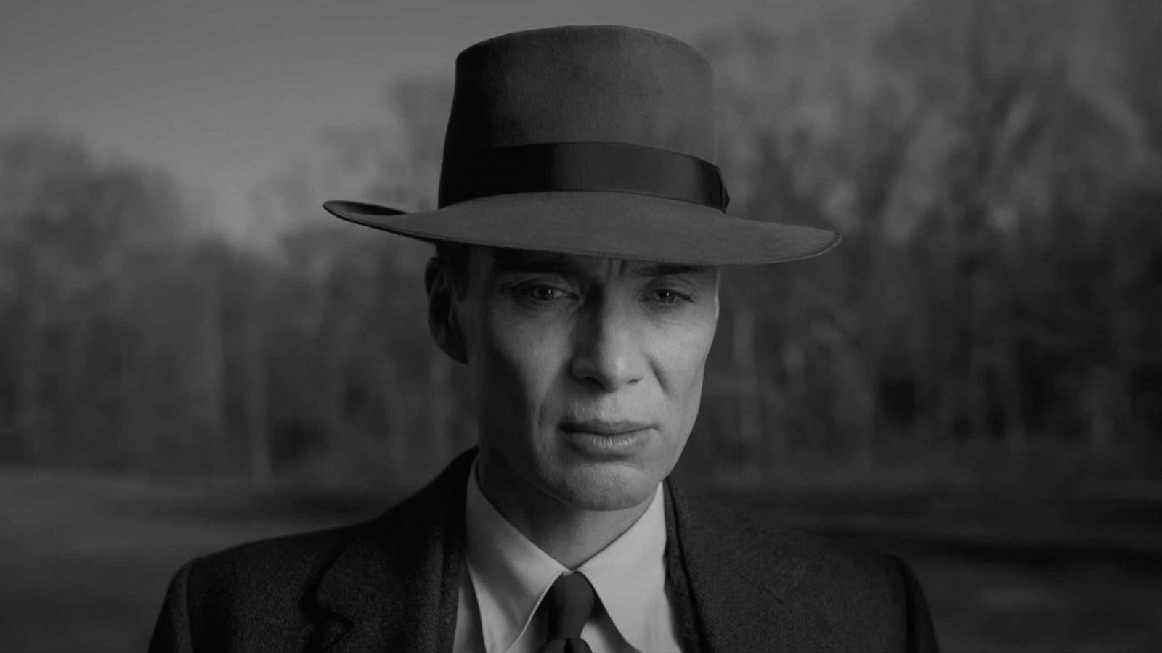
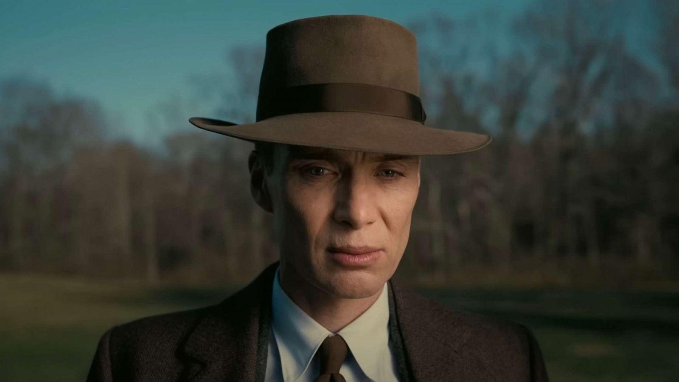

Slide 3
Objective of the project
To automatically add color to grayscale images using deep neural networks.
Utilizing pre-trained models for efficient and accurate colorization

Slide 4
Tools and libraries
Python programming language
Opencv for image processing
Numpy for numerical operation
Deep neural network(dnn) module in opencv

Slide 5
Deep neural network architecture
Loading the pre-trained model using caffe.
Layers involved in the colorization process.
Explanation of class8_ab and
Conv8_313_rh layers.

Slide 6
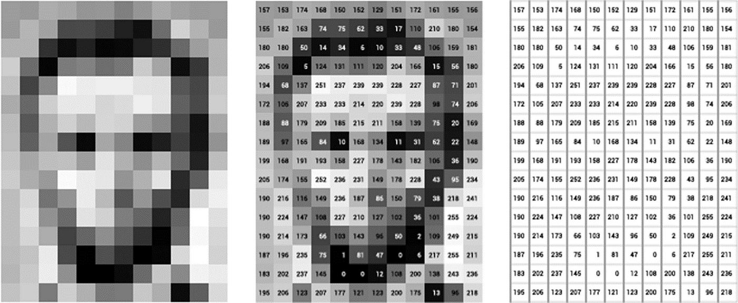
Setting up the model
Loading pre-trained weights and configuration.
Initialization of key layers with necessary parameters.
Loading color space transformation points.

Slide 7
Image preparation
Reading the input image.
Scaling and converting the image to lab color space.
Resizing and adjusting pixel values.

Slide 8
Adding color to grayscale
Splitting the lab image into l , A AND B channels.
Feeding the l channel to the neural network.
Obtaining color predictions (ab channel) from the network.

Slide 9
Final step
Resizing and arranging colorized channels.
Converting lab back to bgr color space.
Clipping and adjusting pixel values.

Slide 10
thank you

